Slide 1
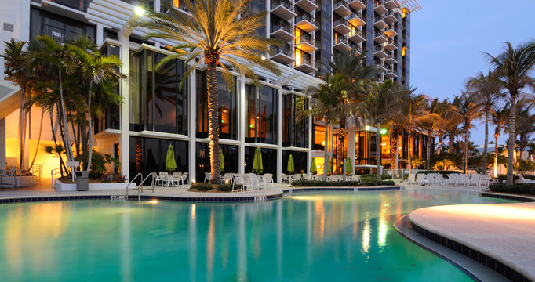
Hotel Reservation Analysis
Q1. What is the total number of reservations in the dataset?
select count(booking_id) as total_no_of_reservations from hotelreserv.hotelreservation;
700
Q2. Which meal plan is the most popular among guests?
select type_of_meal_plan from hotelreserv.hotelreservation group by 1 order by count(booking_id) desc limit 1;
Meal Plan 1
Q3. What is the average price per room for reservations involving children?
select avg_price_per_room from hotelreserv.hotelreservation where no_of_children !=0;
82.44,258,159.3,130.5,156.9,184.24,102.83,190.8,121.5,87.4,150,87.78,86.32,177.65,200.75,127,135.15,125.1,187.85,108.38,76.5,104.5,239,132.9,103.7,168.25,199,147.9,221,73.83,152.1,156.61,106.43,168,187.04,83.03,122,172.8,106,121.5,186.22,95,156,115.68,195.5,172.55,166.35,150

Slide 2
Q4. How many reservations were made for the year 20XX (replace XX with the desired year)?
#For 2017 select count(booking_id) as booking_count from hotelreserv.hotelreservation where right(arrival_date,4) =2017;
123
#For 2018 select count(booking_id) as booking_count from hotelreserv.hotelreservation where right(arrival_date,4) =2018;
577
Q5. What is the most commonly booked room type?
select room_type_reserved from hotelreserv.hotelreservation group by 1 order by count(booking_id) desc limit 1;
Room_Type_1
Q6. How many reservations fall on a weekend?
select count(booking_id) as booking_count from hotelreserv.hotelreservation where no_of_weekend_nights!=0;
383
Q7.What is the highest and lowest lead time for reservations?
select max(lead_time) as highest_lead_time,min(lead_time) as lowest_lead_time from hotelreserv.hotelreservation;
443 , 0
Q8. What is the most common market segment type for reservations?
select market_segment_type from hotelreserv.hotelreservation group by 1 order by count(Booking_ID) desc limit 1;
Online
Room_Type 1 | 534

Slide 3
Q9. How many reservations have a booking status of "Confirmed"?
select count(booking_id) as booking_count from hotelreserv.hotelreservation where booking_status="Not_Canceled";
493
Q10. What is the total number of adults and children across all reservations?
select sum(no_of_adults) as adult_count,sum(no_of_children) as children_count from hotelreserv.hotelreservation;
1316, 69
Q11. What is the average number of weekend nights for reservations involving children?
select avg(no_of_weekend_nights) as avg_no_of_weekend_nights from hotelreserv.hotelreservation where no_of_children!=0;
1
Q14 For reservations involving children, what is the most common room type, and what is the average
price for that room type?
select room_type_reserved,avg_price_per_room from hotelreserv.hotelreservation where no_of_children!=0 group by 1,2 order by count(Booking_ID) desc limit 1;
Room_Type_1 with avg_price_per_room 150 and 121.5 are most commonly booked
Q15. Find the market segment type that generates the highest average price per room.
select market_segment_type from hotelreserv.hotelreservation group by 1 order by max(avg_price_per_room) desc limit 1;
Online

Slide 4
Q12. How many reservations were made in each month of the year?
select right(arrival_date,7)as month_year,count(Booking_ID) as booking_count from hotelreserv.hotelreservation group by 1 order by 1 desc;
Month_year | booking_count
Dec-18 | 39
Dec-17 | 13
Nov-18 | 41
Nov-17 | 13
Oct-18 | 63
Oct-17 | 40
Sep-18 | 45
Sep-17 | 35
Aug-18 | 56

Slide 5
Month_year | booking_count
Aug-17 | 14
Jul-18 | 36
Jul-17 | 8
Jun-18 | 84
May-18 | 55
Apr-18 | 67
Mar-18 | 52
Feb-18 | 28
Jan-18 | 11

Slide 6
Q13. What is the average number of nights (both weekend and weekday) spent by guests for each room type?
select room_type_reserved,avg(no_of_weekend_nights+no_of_week_nights) as avg_number_of_nights from hotelreserv.hotelreservation group by 1;
Room_type_reserved | Avg_no_of_nights
Room_Type 1 | 2.8783
Room_Type 4 | 3.8
Room_Type 2 | 3
Room_Type 6 | 3.6111
Room_Type 5 | 2.5
Room_Type 7 | 2.6667

